Slide 1
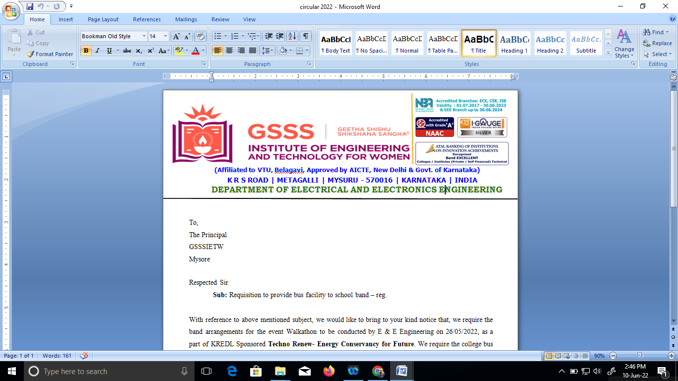

PESTICIDE SPRINKLER WITH IOT BASED SECURITY
by
Bhoomika C P 4GW19EE005
Prakruthi K N 4GW19EE026
Rakshitha G 4GW19EE030
Vidyashree K 4GW19EE041
Under the Guidance of
Smt. SHILPASHRI V N
Assistant Professor
Dept. of EEE, GSSSIETW, Mysuru
Department of Electrical & Electronics Engineering

Slide 2
Overview
Introduction
Literature survey
Scope of project
Objectives
Methodology
Hardware & Software Description
Expected Outcome
References

Slide 3
Introduction
The rural population depends on agriculture. Aimed at increasing crop yield and reducing labor involved various kinds of agricultural robots have been proposed and developed.
It is programmed to carry out the required function. Robot has a sprayer equipped with sprinkler which is controlled by a relay.
The goal of agriculture robotic is more than just the application of robotic technologies to agriculture. If any intruder is detected the photo can be taken by the IOT.
The adverse effects of pesticides can be prevented.

Slide 4
Literature Review
Development of A Wireless Surveillance Robot For Long Distance - A robot has been developed which can be used for multipurpose application related to surveillance and security system. From ground testing it has been found that it can be controlled from unlimited distance as it is based on World Wide Web(WWW).
Design and Implementation of Remote Operated Spy Robot Control System - Spy robots are the remotely controlled robots , equipped with a wireless camera, an antenna , batteries and four movable wheels. Two different PICs are used to remotely control of the wireless system and also to control the spy robot.
Microcontroller Based Security System With Intruder Position – The microcontroller based security system with Intruder Position Display is a design , that applies automated security system. The sensors will receive the signal when the intruder is around , while the control program will translate the received signal from sensor to useful information about function of the system.

Slide 5
Scope of Project
In future by implementation of slot based system in which two tanks can be used. And different pesticides liquid will be filled in different tanks depending on which spray the crop requires and spray effectively on farms which consists of two different crops according to their requirement.
We can also increase the one time spraying capacity of the sprayer by using more RPM motors for a bigger system.

Slide 6
Objectives
To spray pesticides effectively on the land by sitting at one place.
To implement the IOT system in agriculture.
To speed up the pesticides spraying operation.
Ensuring safety of the system.

Slide 7
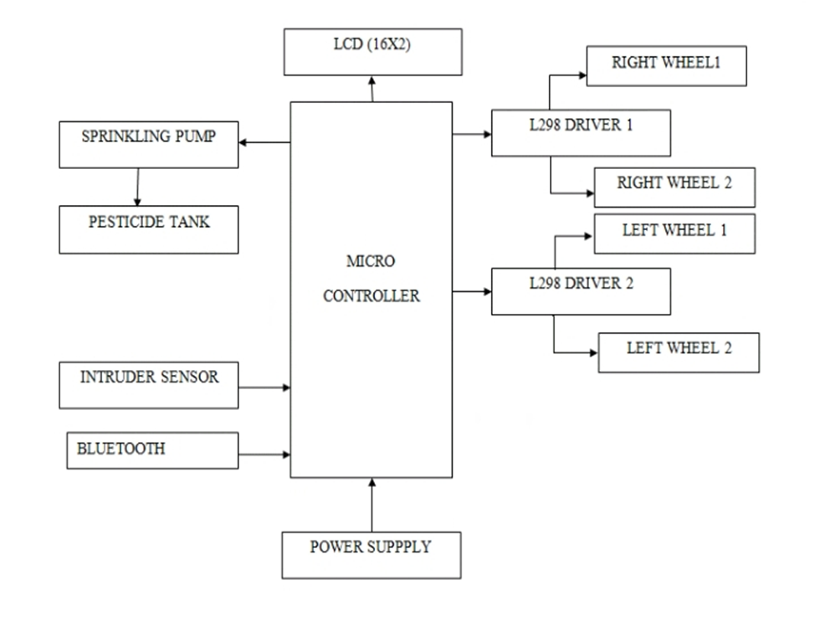
Methodology

Slide 8
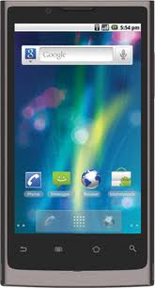

PESTICIDE CONTROL SECTION

Slide 9
The robot is placed in the farm and is switched on through IOT and its direction controlled by Android application.
The spraying of pesticides which can be done with the help of pesticide sprinkling pump and is periodically sprayed whenever the relay switch is on.
The system focused on the design, development and the fabrication of the agricultural robot with pesticide spraying system in addition to security system using IOT.

Slide 10
Hardware & Software Description
HARDWARE COMPONENTS
Microcontroller
Pesticide Sprinkler
Pesticide Tank
DC Driving Motors
Intruder sensor
LCD Display
DC Motors
Bluetooth

Slide 11
SOFTWARE COMPONENTS
Arduino IDE
Embedded C

Slide 12
EXPECTED OUTCOME
To decrease the work load on the farmers and the severe health problems faced by them .
If successful in constructing this sprayer it can travel on rough surfaces in the field and sustain enough load of other equipments.
This concept will be presented in a suitable manner to Indian market. It also increases the farmers production and reduces effort taken by them by spraying out the pesticides automatically.

Slide 13
REFERENCE
[1] Tahesin Attar, Prajakta Chavan, Vidhi Patel, Megha Gupta, Debajyoti Mukhopadhyay, “An Attempt to Develop an IOT based Vehicle Security System” , 2018, IEEE International Symposium on Smart Electronic Systems (iSES) (Formerly iNiS).
[2] Shahajada Mahmudul Hasan, Syed Mamun R Rasid, Avijit Mallik, Md. Rokunuzzaman, “Development of a Wireless Surveillance Robot for Controlling from Long Distance”, International Journal of Engineering Research and Management(IJERM), ISSN: 2349- 2058, Volume-05, Issue-09, September 2018.
[3] Mr. V. Gowrishankar, Dr. K. Venkatachalam, “GRD Journals- Global Research and Development Journal for Engineering”, Volume 3, Issue 5, April 2018.
[4] Prathibha S R, Anupama Hongal, Jyothi M P, “IOT Based Monitoring System in Smart Agriculture”, 2017, International Conference on Recent Advances in Electronics and Communication Technology.
[5] Priyanka Yadav, Leena Chaudhari, Swati Gawhale, “War Field Spying Robot with Wireless Night Vision Camera”, International Journal for Research in Applied Science & Engineering Technology(IJRASET), 2017.
[6] S Mahendra Kumar and T Guna Sekar, “Cross-Layer Design for Energy Efficient Multicast Video Transmission over Mobile Ad Hoc Networks”, Asian Journal of Research in Social Sciences and Humanities, Volume 6, Issue 9, Pages 719-734, 2016

Slide 14
. [7] V Gowrishankar, K Venkatachalam, “Survey on Performance Analysis of Data Converters for Sensor Network Applications”, Vol. 6, Issue 8, 2016. [8] H. L. Kushwaha, J. P. Sinha, T. K. Khura, Dilip Kumar Kushwaha, Uttpal Ekka, Mayank Purushottam and Nishtha Singh ,“Status and Scope of Robotics in Agriculture”, International Conference on Emerging Technologies in Agricultural and Food Engineering ,30th December, 2016. [9] Ashish Lalwani, mrunmai Bhide, S. K. Shah, “ A Review:Autonomous Agribot for Smart Farming”, 46th IRF International Conference, 2015. [10] Gulam Amer, S.M.M. Mudassir, M.A. Malik, “Design and operation of Wi-Fi Agribot Integrated system”, International Conference on Industrial Instrumentation and control (ICIC), IEEE, 2015. [11] Tushar Maheshwaril, Upendra Kumar, Chaitanya Nagpae, Chandrakant Ojha and V. K . Mitta, “Capturing the spied image-Video data using a flexi-Controlled spy- robot”, 2015, Third International Conference on Image Processing. [12] Amritanshu Srivastava, Shubham Vijay, Alka Negi, Akash Singh,“DTMF Based Intelligent Farming Robotic Vehicle,” International Conference on Embedded Systems (ICES ), IEEE 2014. [13] V Gowrishankar, K Venkatachalam, “Efficient FIR Filter Design Using Modified Carry Select Adder & Wallace Tree Multiplier”, Vol. 2, Issue 3, 2013, page. 703-711. [14] AkhilaGollakota,M.B.Srinivas,“Agribot-A multipurpose agricultural robot”,IndiaConference (INDICON), IEEE, 2011. [15] “Design and Implementation of Remote Operated Spy Robot Control System”, in-press. [16] “Microcontroller Based Security System with Intruder Position”, unpublished. [17] Parameshachari B D et. Al Optimized Neighbor Discovery in Internet of Things (IoT), 2017 International Conference on Electrical, Electronics, Communication, Computer and Optimization Techniques (ICEECCOT), PP 594-598, 978- 1-5386-2361-9/17/$31.00 ©2017 IEEE.

Slide 15


